Slide 1

WIPRO NGA Program – 25SUB4530_CP_JAVA
Capstone Project Presentation – 9th Feb & 10th Feb 2026
Project Title Here -
Insurance Policy Management System
Ananmay Anand & Boddeti Musilinaidu
Presented by -
Team - 2
www.rpsconsulting.in

Slide 2
PROJECT DESCRIPTION
Insurance Policy Management System is a web-based application designed to manage insurance policies and customer policy details efficiently.
The system allows insurance providers to:
Create and manage insurance policies
Assign policies to customers
Track policy status throughout its lifecycle
The application provides a user-friendly interface for customers and administrators while ensuring secure and reliable backend processing.

Slide 3
SYSTEM OVERVIEW
Frontend: Angular-based user interface
Backend: Spring Boot REST APIs
Database: Relational database for persistent storage
Deployment: Docker containerized application deployed on Azure Cloud
Admin: Start → Login → Create Policy → Review Applications → Approve/Reject → End
Customer: Start → Register → Login → View Policies → Apply → Track → End

Slide 4
KEY OBJECTIVES
Digitize insurance policy management processes Convert all policy operations from manual paperwork to a centralized digital system.
Improve tracking and visibility of policy information Allow real-time access to policy status, details, and history for both admin and customers.
Reduce manual effort and processing time Automate policy application, approval, and updates to minimize human intervention and delays.
Provide role-based access for Admin and Customer Ensure users can access only the features and data relevant to their assigned role.
Ensure data validation and error handling Validate user inputs and handle system errors gracefully to maintain data accuracy and reliability

Slide 5
SYSTEM USERS
Admin
Customer
Creates and manages insurance policies
Views registered customers
Approves or rejects policy requests
View all Customers
Registers and logs into the system
Views available insurance policies
Applies for policies
Tracks policy status

Slide 6
ADMIN MODULE
Category | Action / Feature | Description
Policy Management | Create Policy | Admin enters policy name, premium amount, duration (years), and description. System validates and saves the policy in the database.
Policy Management | View Policies | Admin can view policy name, premium amount, duration, and description for effective monitoring.
Customer Management | View Customers | Admin can view customer name, email ID, phone number, and date of birth to ensure transparency.
Policy Requests | View Pending Requests | Admin can view pending policy requests with customer name, policy name, and status as Pending.
Policy Requests | Approve Policy | On approval, policy start date is set to the current date, end date is calculated based on duration, and status becomes Approved.
Policy Requests | Reject Policy | On rejection, the policy status is updated to Rejected.

Slide 7
CUSTOMER MODULE
Category | Action / Feature | Description
Account Management | Customer Registration | Customer registers by providing a unique username, password, valid Gmail address, 10-digit phone number, and past date of birth. System validates all inputs before account creation.
Policy Viewing | View Available Policies | Customer can view policy name, premium amount, duration, and description to make informed decisions.
Policy Application | Apply for Policy | Customer selects a policy and clicks Apply. The request is sent to admin and the initial status is set to Pending.
Policy Tracking | Track Policy Status | Customer can view applied policy details including policy name and status (Pending, Approved, or Rejected).
Policy Tracking | View Policy Duration | After approval, customer can view policy start date and end date calculated based on policy duration.

Slide 8
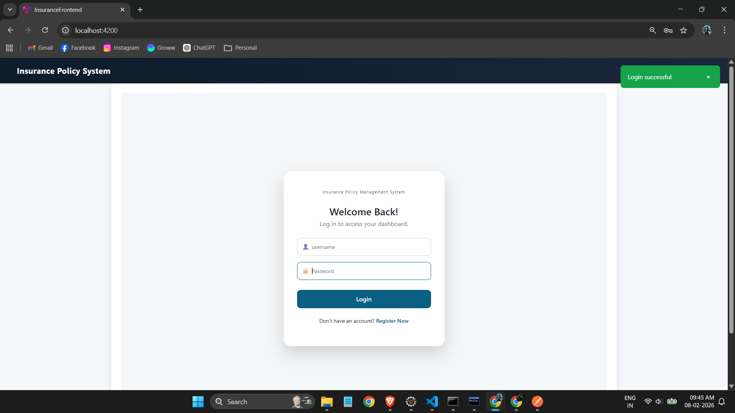
Admin Login
Application opens with a Login Page
User enters username and password
Backend validates credentials
Based on role:
Admin → Admin Dashboard
Customer → Customer Dashboard
Invalid credentials display an error message

Slide 9
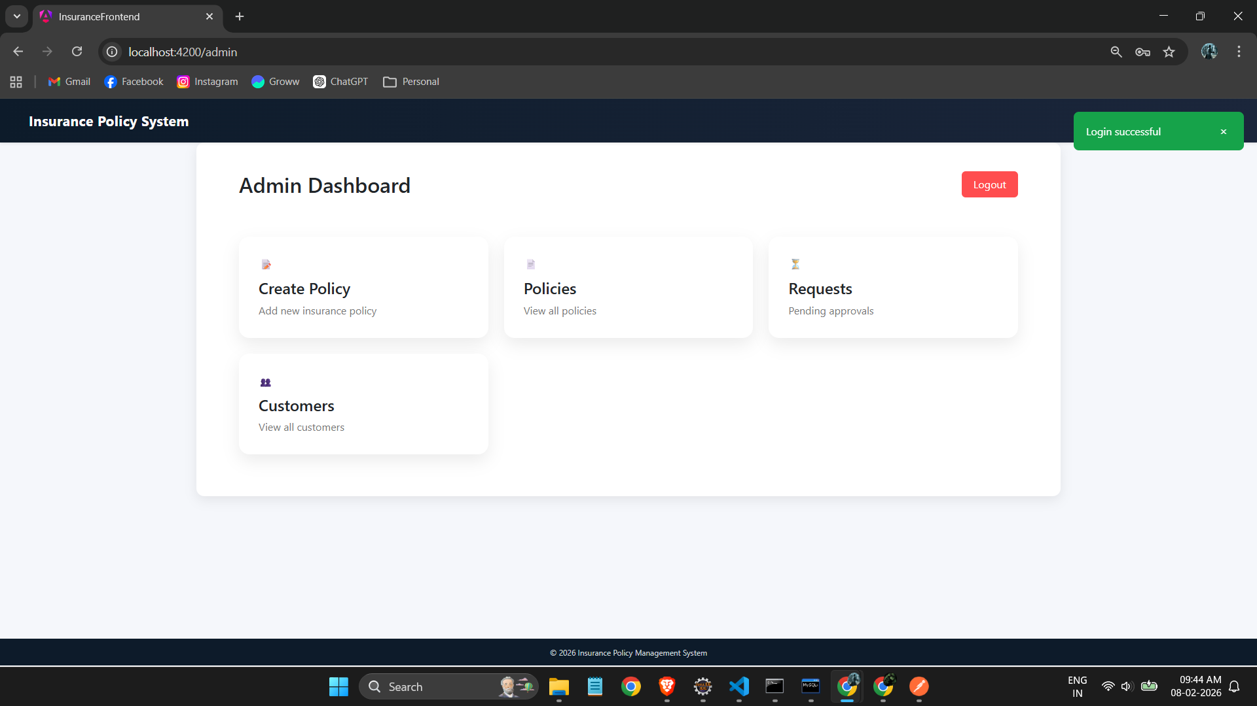
Admin Dashboard
The Admin Dashboard is the central control panel for managing the insurance system.
Key Features:
Create and manage insurance policies
View all existing policies
Review and approve/reject customer policy requests
View registered customer details
Purpose: Provides centralized control, faster policy approvals, and efficient system monitoring.

Slide 10
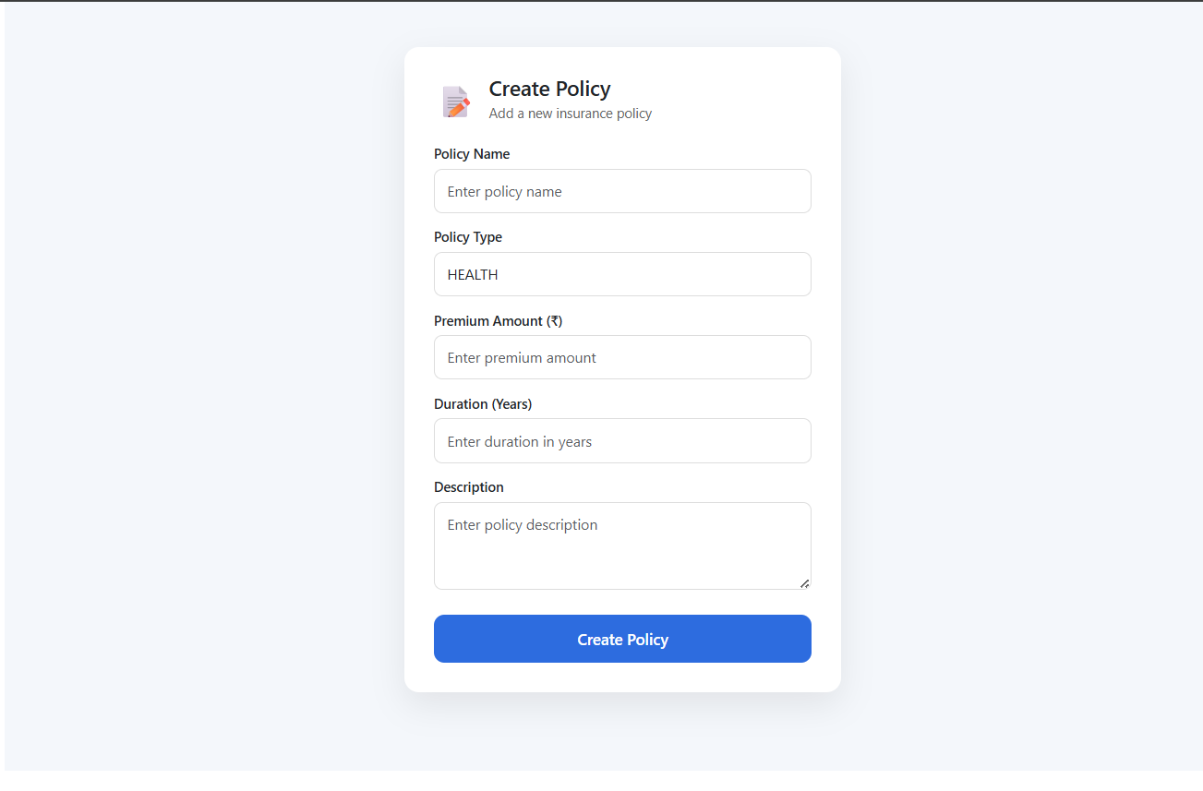
Admin Dashboard : Create Policy
This screen allows the admin to create new insurance policies in the system.
Key Details Added:
Policy Name
Policy Type
Premium Amount
Policy Duration
Policy Description
Purpose: Enables administrators to define and publish insurance policies that are made available to customers.

Slide 11
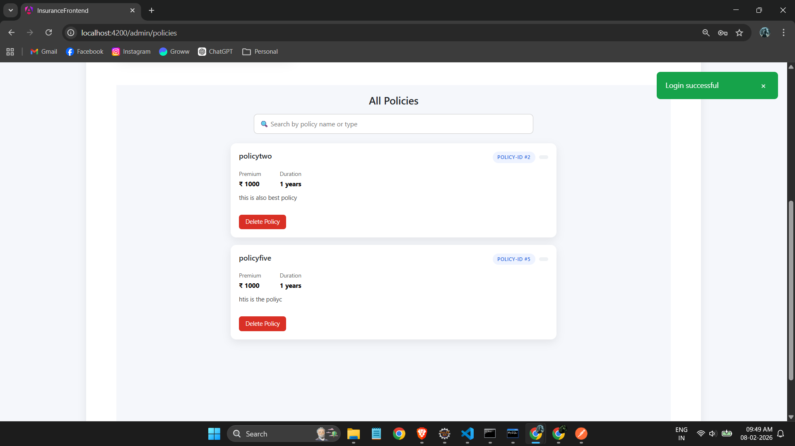
Admin Dashboard : All Policies
This screen displays all insurance policies available in the system.
Key Features:
View policy details such as premium, duration, and description
Search policies by name or type
Delete outdated or inactive policies
Purpose: Helps the admin monitor, manage, and maintain all insurance policies efficiently.

Slide 12
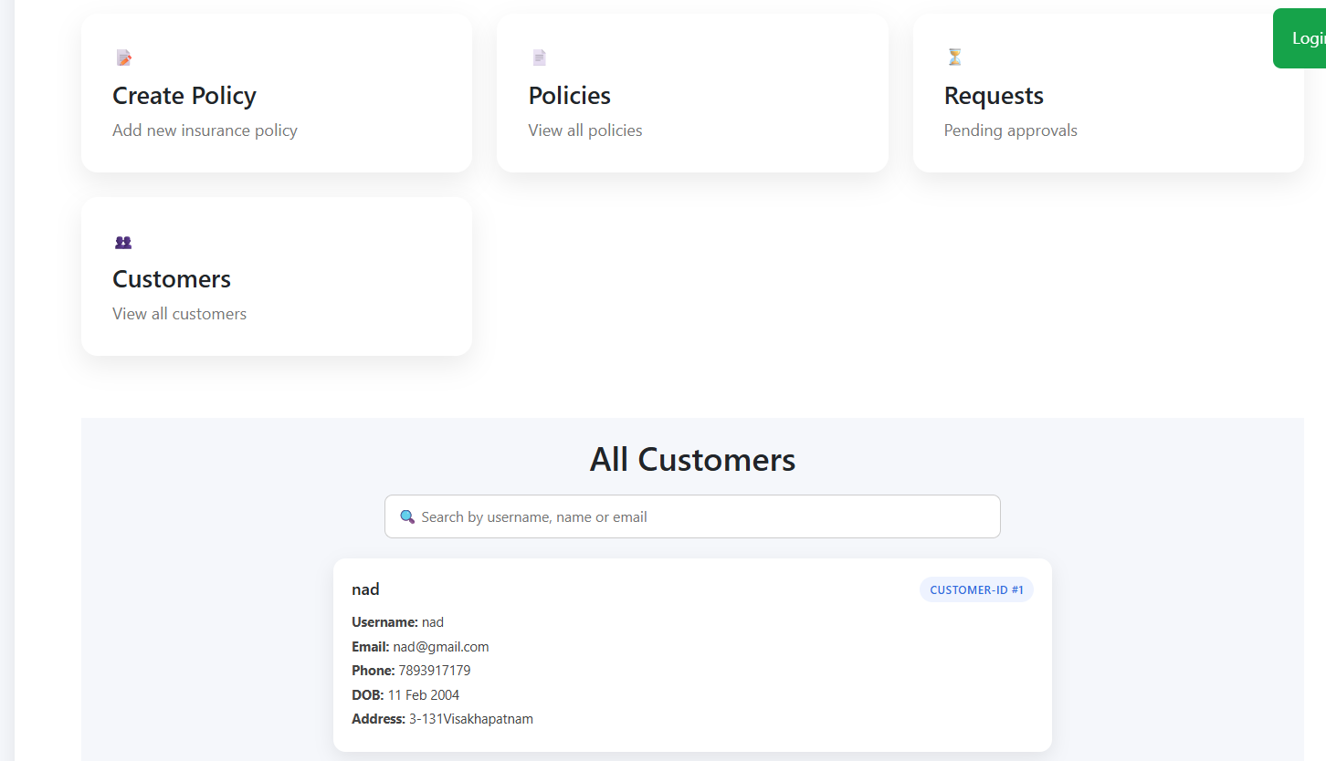
Admin Dashboard: Customer Details
This screen allows the admin to view all registered customers in the system.
Key Features:
View customer profile details
Search customers by username or email
Monitor customer registrations and activity
Purpose: Helps administrators manage customer data and maintain transparency across the system.

Slide 13
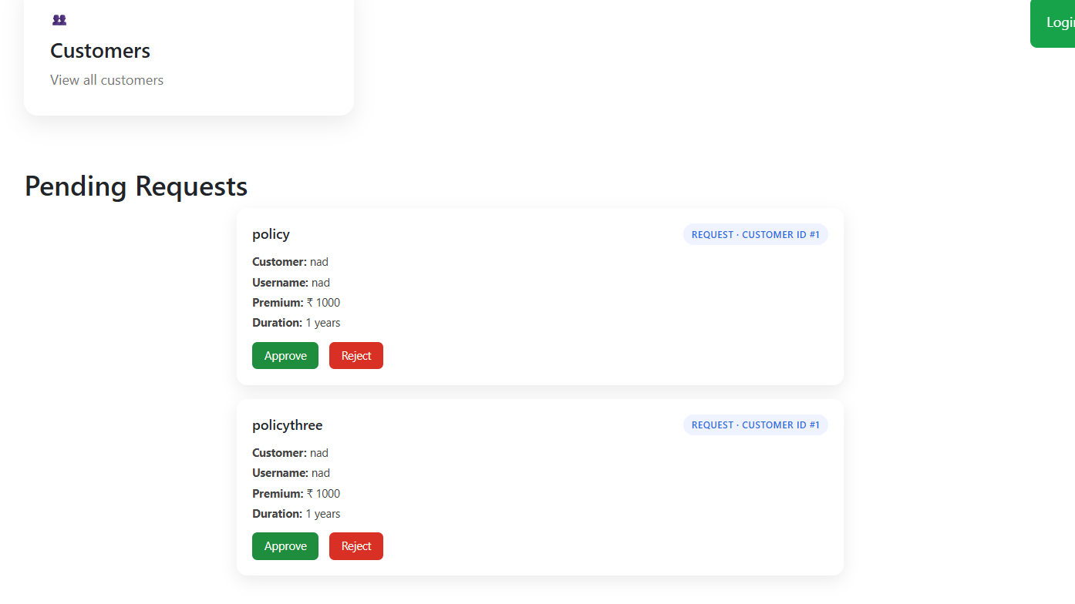
Admin Dashboard: Policy Requests
This screen displays all pending insurance policy requests submitted by customers.
Key Features:
View customer and policy details
Review pending applications
Approve or reject policy requests
Purpose: Allows the admin to make decisions on policy applications and update policy status efficiently.

Slide 14
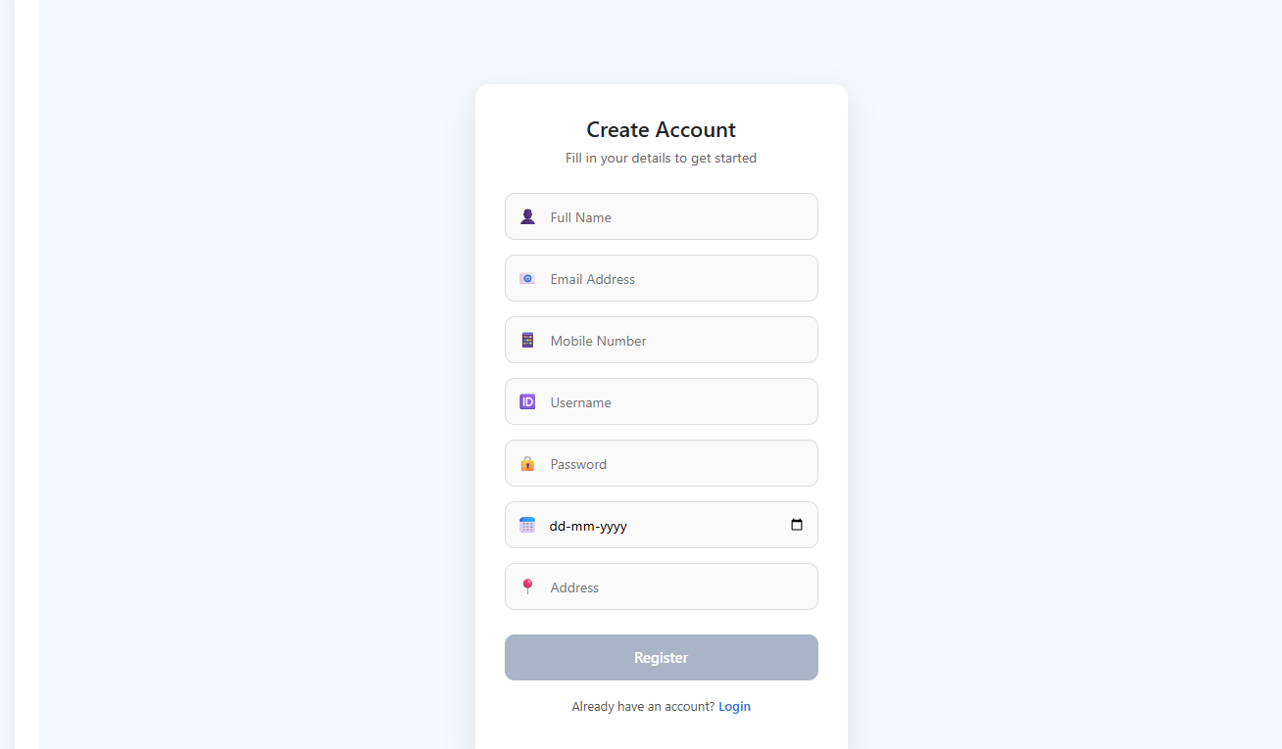
New Customer: Register
his screen allows a new customer to create an account in the system.
Key Details Collected:
Full Name
Email Address
Mobile Number
Username & Password
Date of Birth
Address
Purpose: Registers the customer securely and enables access to insurance policies and services.

Slide 15
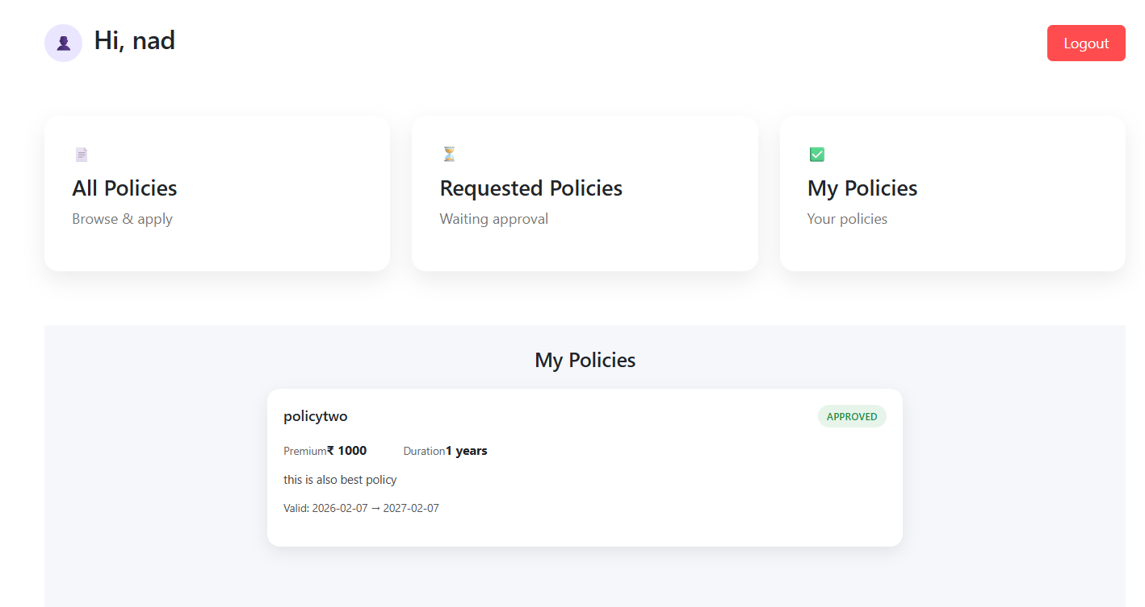
Customer Dashboard: Details
The Customer Dashboard provides an overview of the customer’s insurance activities.
Key Features:
View all available insurance policies
Track requested policies and approval status
View active and approved policies
Purpose: Allows customers to manage policies and track their insurance status from a single dashboard.

Slide 16
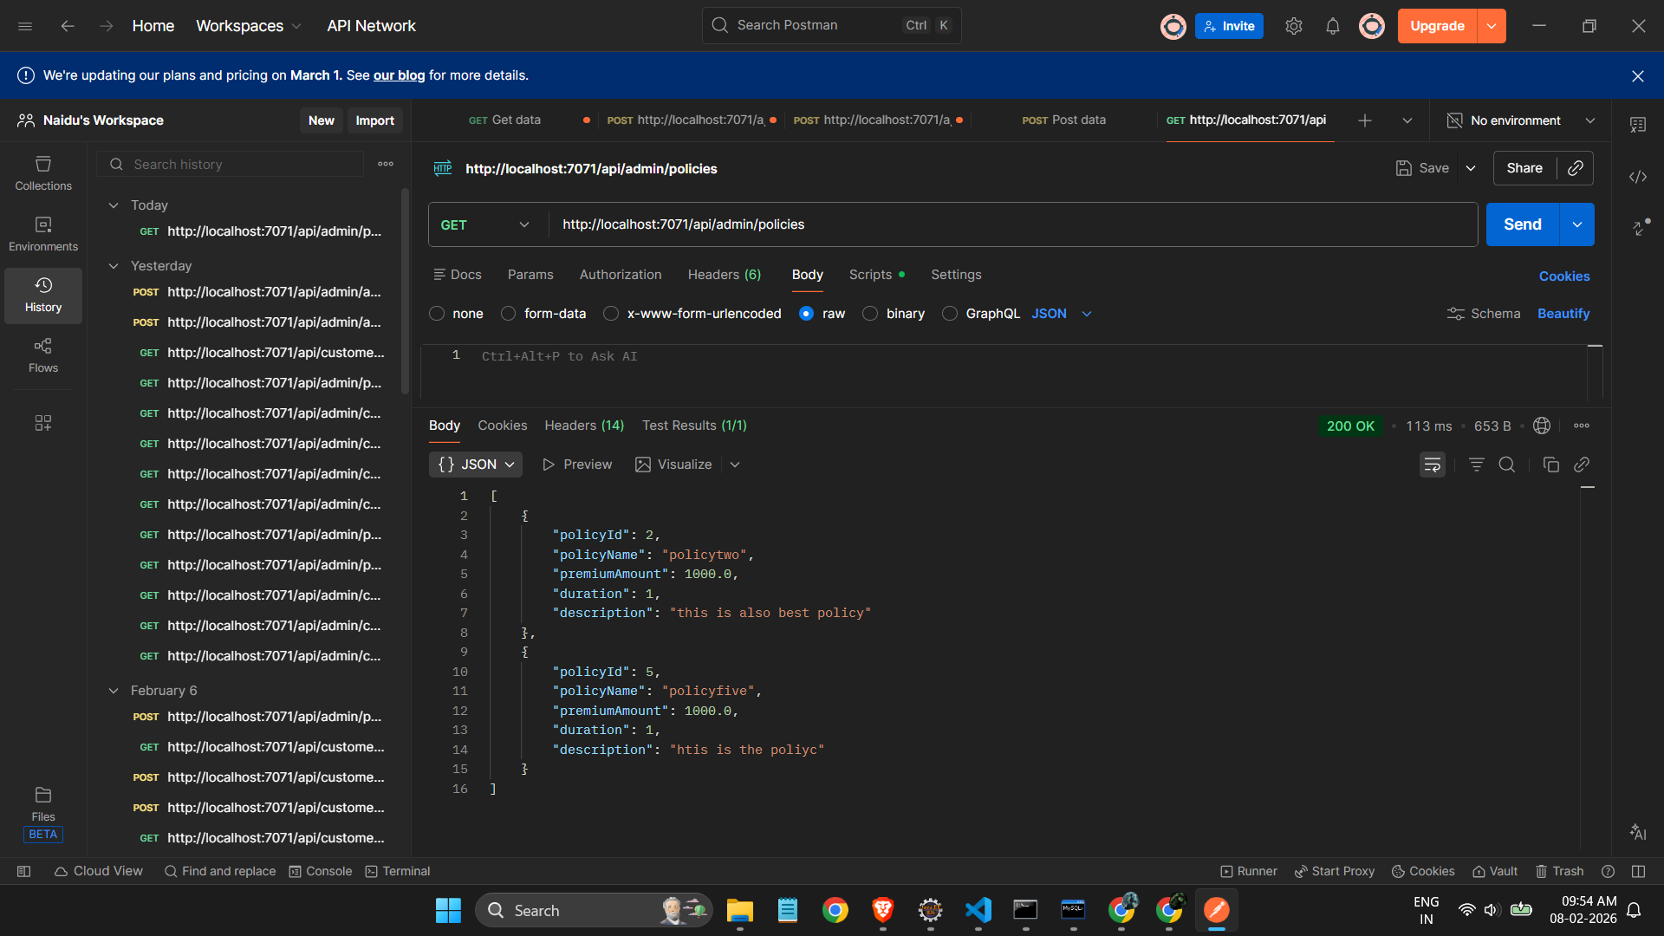
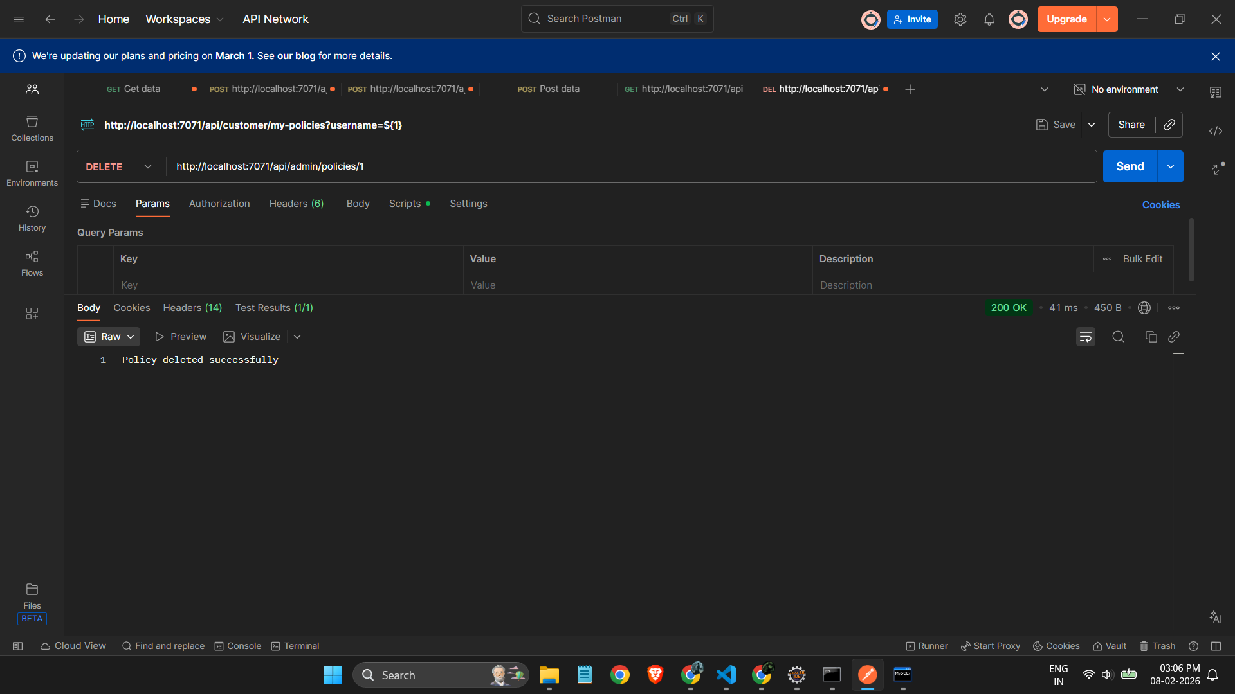
Postman Checks

Slide 17
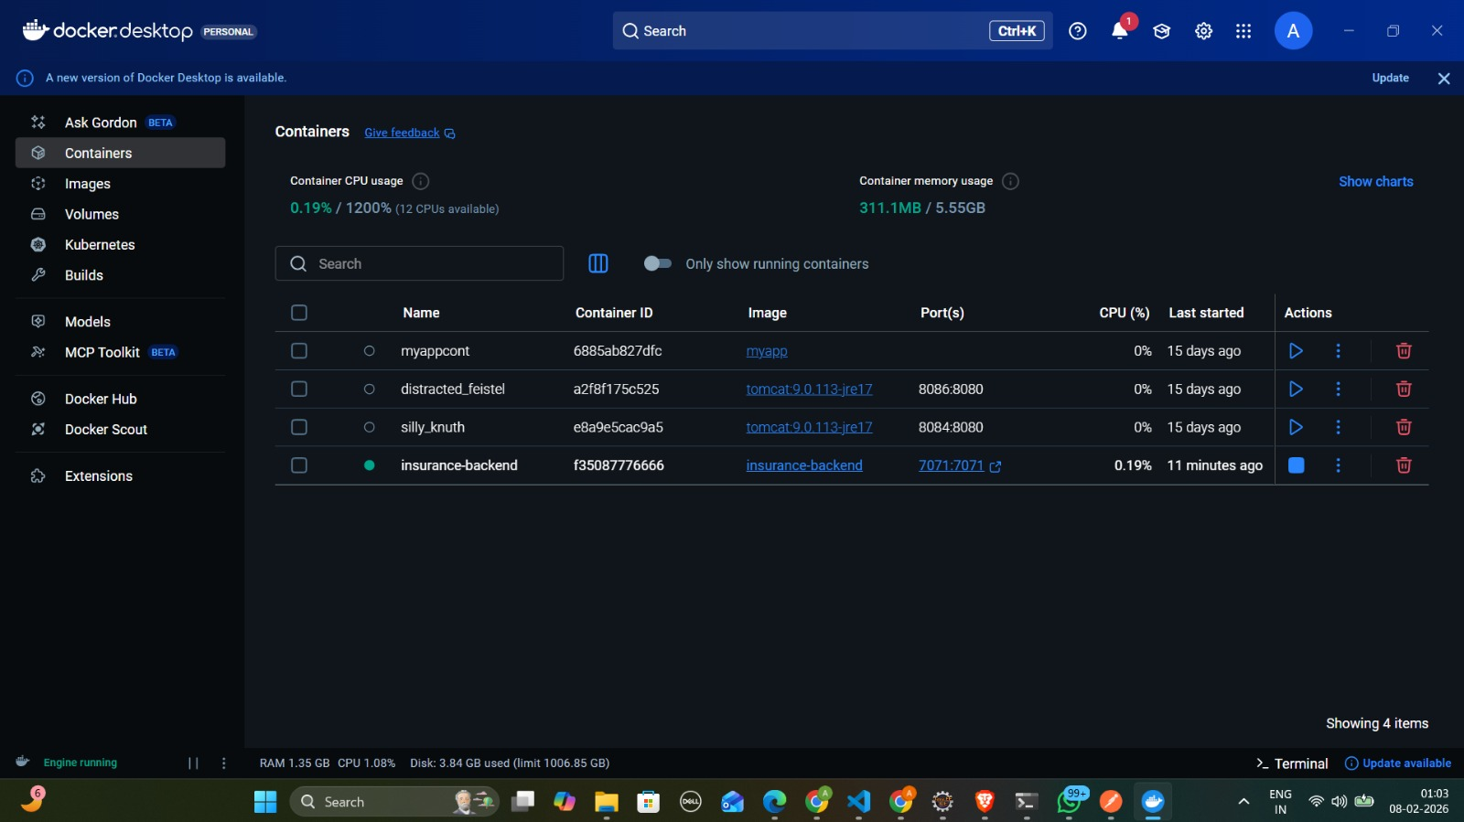
Docker Deployment

Slide 18
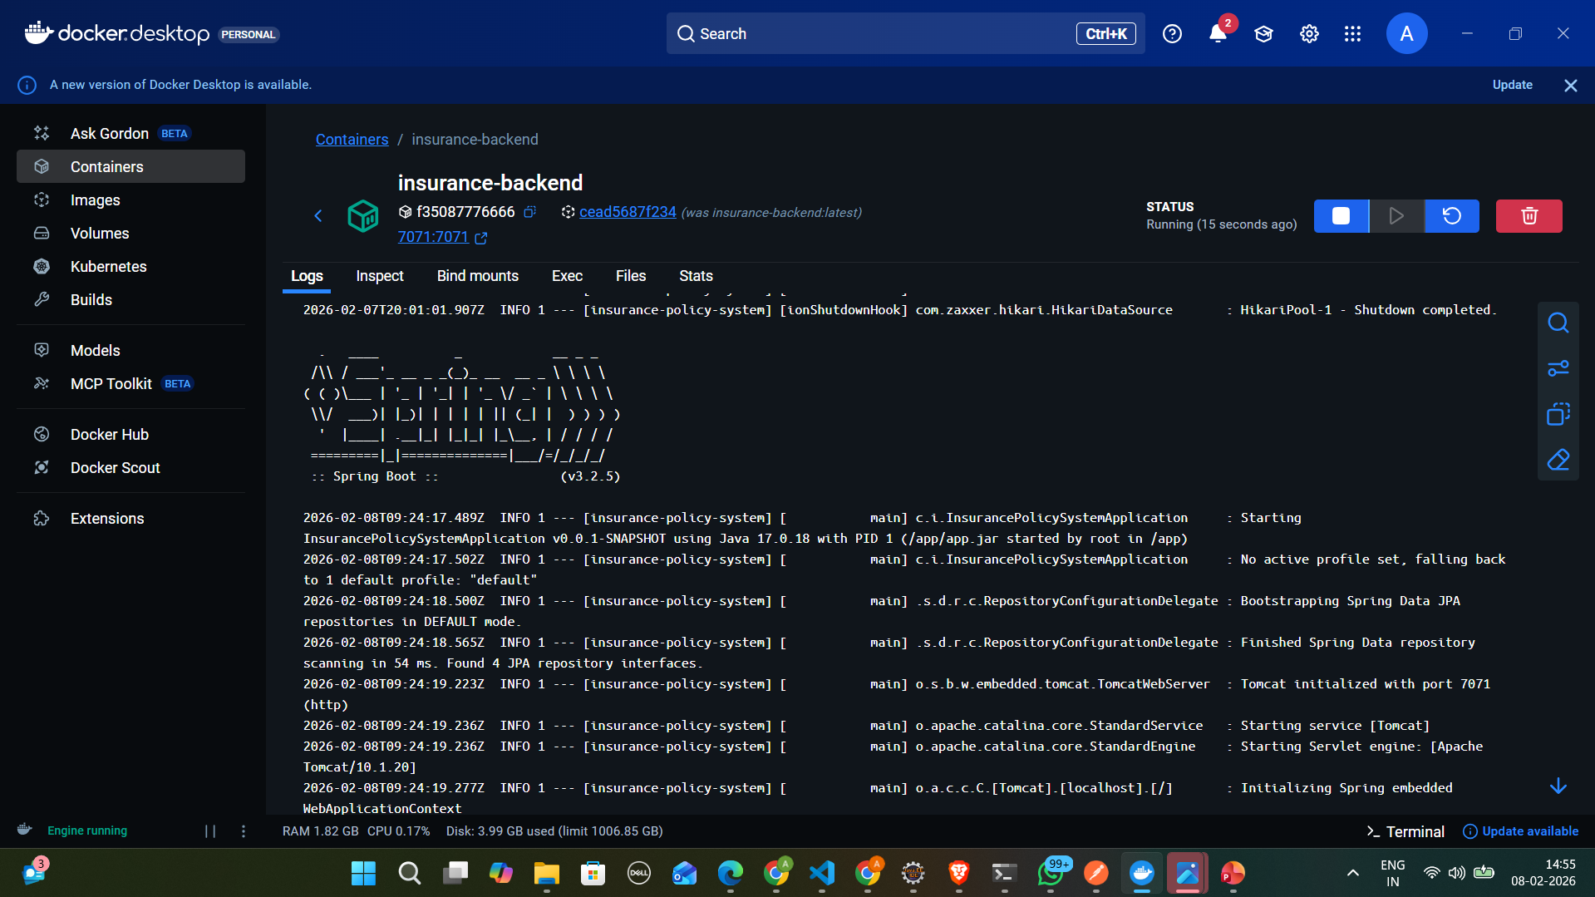

Slide 19
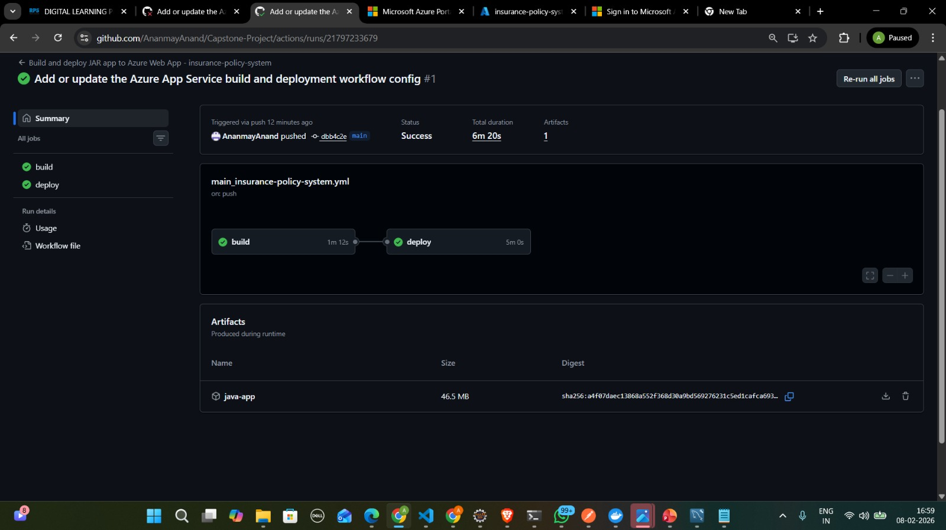
Azure Deployment

Slide 20
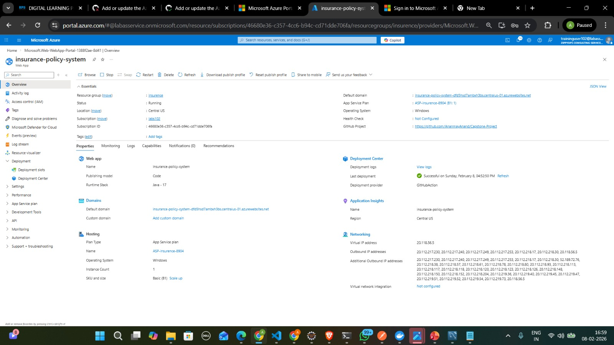

Slide 21
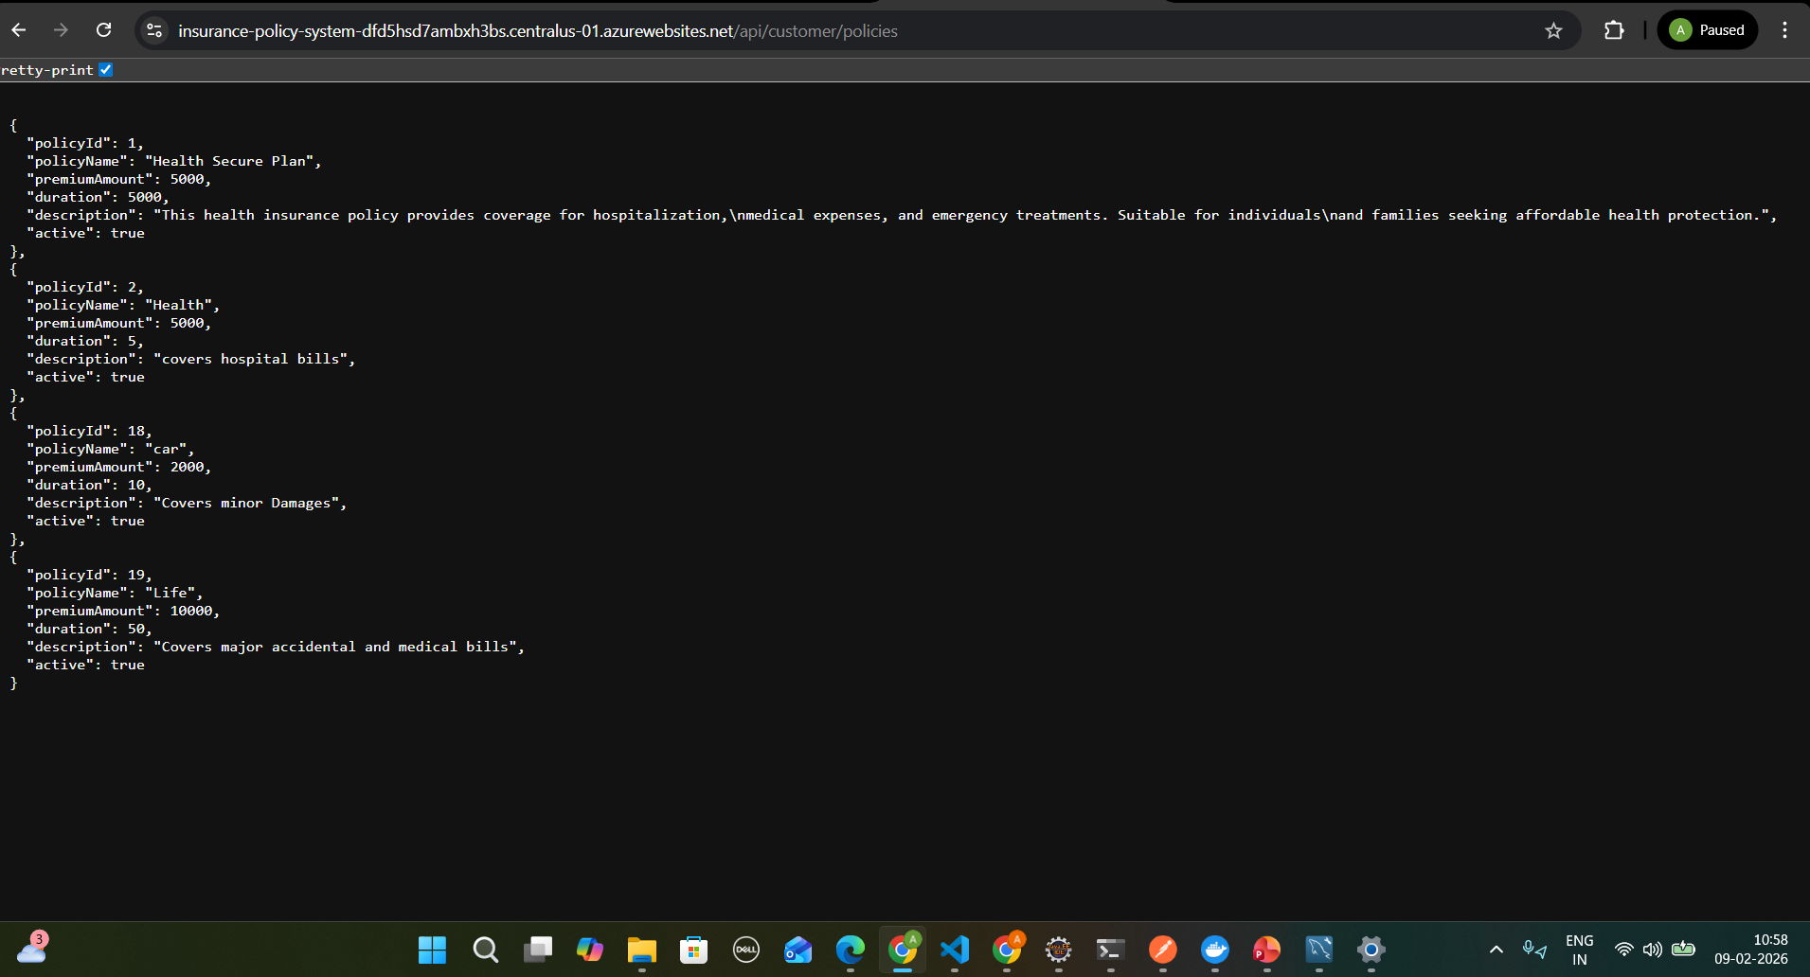

Slide 22
Thank you

